Slide 1
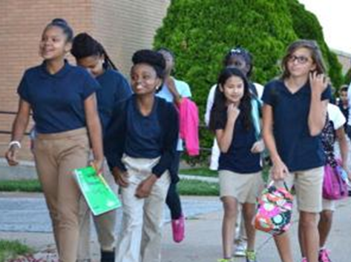
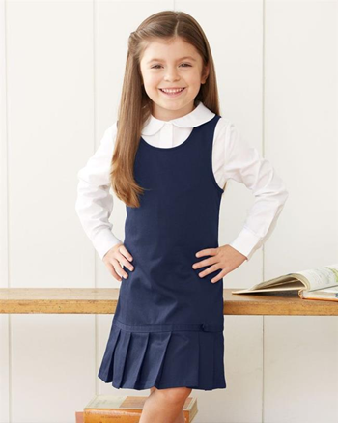
Ponce de Leon Elementary School
Modified School Uniform
“We’re on Our Way to an ‘A’!”

Slide 2
Modified School Uniform Information
Based on the input of stakeholders, we are pursuing the possibility of adopting a modified school uniform policy for the upcoming 2022-2023 school year. Our uniform policy is designed to promote school unity and pride, create a safe and positive climate, and ensure a distraction-free learning environment for all students.
Kindergarten through 5th grade students will be required to adhere to the modified uniform policy. The modified school uniform will not apply to PreK students.
Students are expected to be in uniform every day from the time they enter the school campus until they are off the campus each afternoon.
On specific days during the school year, determined by administration, students will be able to have opportunities to wear clothing outside of the modified school uniform policy. Out-of-uniform days will be communicated to families.

Slide 3
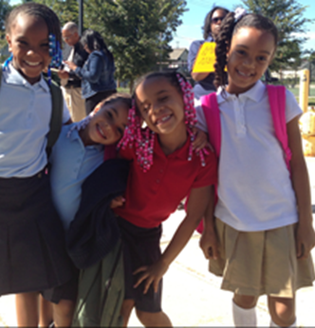
Advantages of Wearing School Uniforms
Inclusiveness: Having a school uniform gives students a school identity. It means they belong to that particular school and promote school spirit.
Promotes safe, focused learning environments
Builds a positive school culture and climate
Bridges socio-economic differences between children
Promoting positive student behavior
Improving children's self-respect and self-esteem
Decreasing student misconduct
Wearing a uniform helps to prepare students for the world of work, where uniforms are often worn.
Schools with uniforms have better educational results.

Slide 4
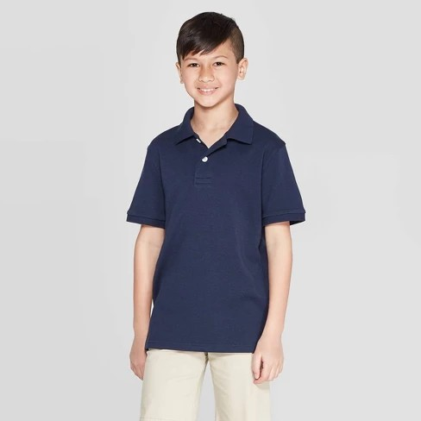
Advantages for Families
Schools with uniforms have better educational results.
You will not have to worry about what your child will wear on a school day.
School uniforms are inexpensive and cheaper than everyday dress.
Uniform are usually practical and comfortable for students to wear.
Uniforms can be handed down to other children in the family or donated to a child in need.
With a uniform you don't need many casual clothes.
Bridges socio-economic differences between children.
Wearing a uniform helps to prepare students for the world of work, where uniforms are often worn.

Slide 5
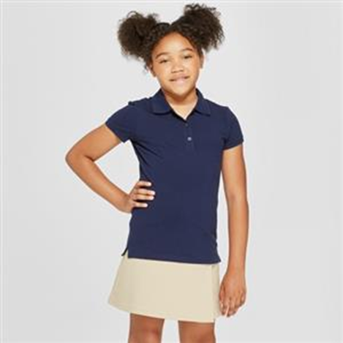
Uniform Information – School Colors
Navy Blue or Khaki slacks, shorts, skirts, or jumpers (No sweatpants, leggings, cargo pants, jeans, sleeveless tops, or baggy clothing. All bottoms must be khaki or navy blue. For young ladies, plain stockings, tights or shorts are permissible to wear underneath skirts.
All shirts must have a collar, with buttons, and must be Red, White, or Navy Blue. (The shirt may not have designs or contrasting colors)
School spirit shirts can be worn on the last day of the week, paired with uniform bottoms.
Students who wear shorts or pants with loops must wear a belt.
Athletic or tennis shoes only. No crocs, sandals/ slides, flipflops, or heels.
NO HOODIES or HATS worn inside the building! (Unless for medical/religious reasons.)

Slide 6








Purchasing School Uniforms
Order Online at www.FrenchToast.com

Slide 7
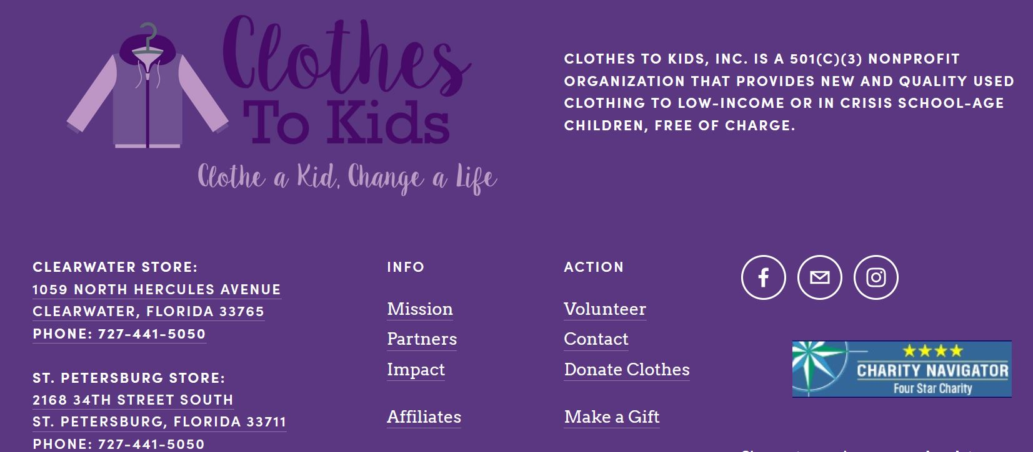
Clothes to Kids Organization
Website
https://clothestokids.org/

Slide 8
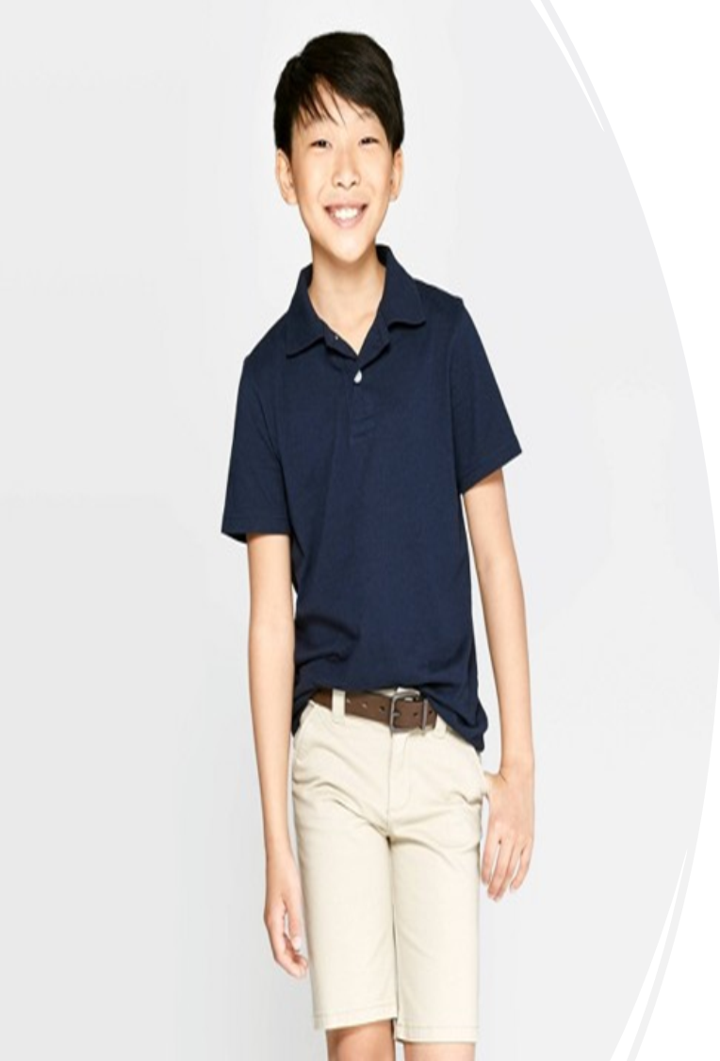
Additional Uniform Details
  Principal approved school spirit wear such as club and/or organizational jackets, spirit shirts, Dual Language Program, Safety Patrols, etc. may be worn on designated days.
  Principal may make exceptions to the uniform policy for special events.
  Principal may make exceptions to the uniform dress code policy for special events such as jeans day.
  Jeans day must be a reward for positive behavior or fundraising for a cause that benefits all the students at the school.

Slide 9
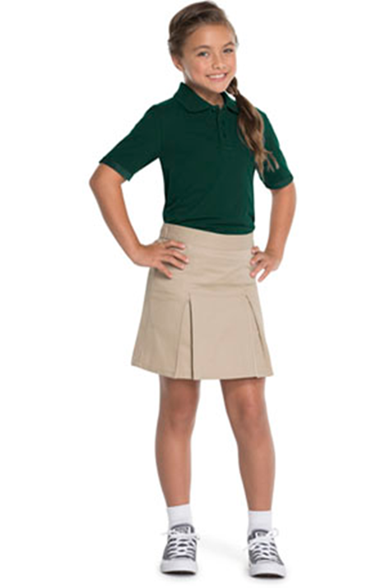
Frequently Asked Questions
  Can sweaters and sweatshirts zip up or button up? Yes. As long as they are appropriately sized (not bulky) and conform to the other portions of the policy, sweaters and sweatshirts can zip up or button up.
  Can girls wear tights to school? Footed tights may only be worn as an accessory under skirts, skirts, dresses, shorts, pants or capris.
  Does no headwear mean that girls are not allowed to wear hair bows, ponytail holders?
  No. Hair bows, ribbons, ponytail holders and barrettes are allowed. Headwear refers to hats, bandanas, etc.

Slide 10
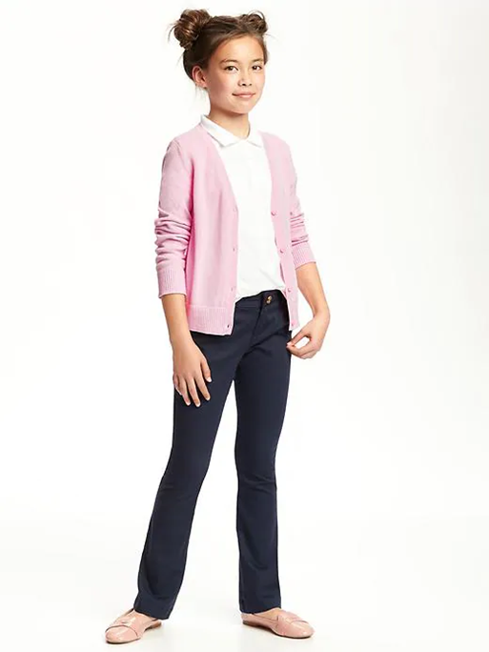
Frequently Asked Questions
Are black or khaki colored jeans be allowed? What about corduroy slacks?
No. Black or khaki colored jeans are not allowed. No denim of any color is allowed. Corduroy slacks are allowed as long as they meet the other guidelines (such as no insignias, logos, words, pictures – other than small labels – and no “cargo” pockets)
Do Pre-K students have to wear the school uniform?
No. Pre-K students will not be required to wear the uniform.

Slide 11
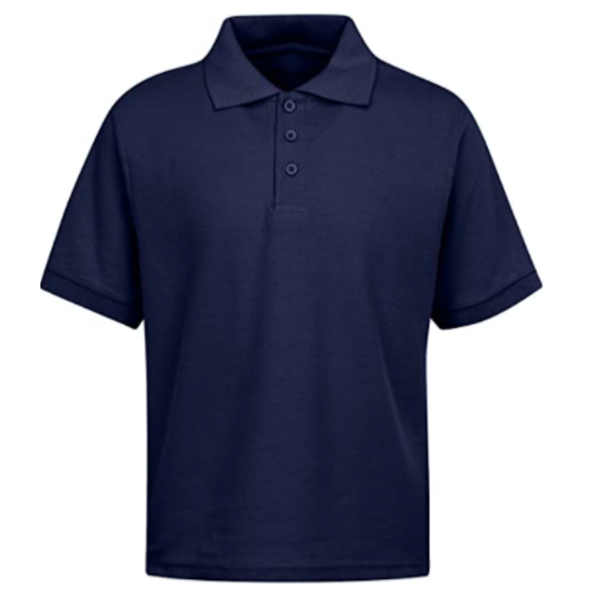
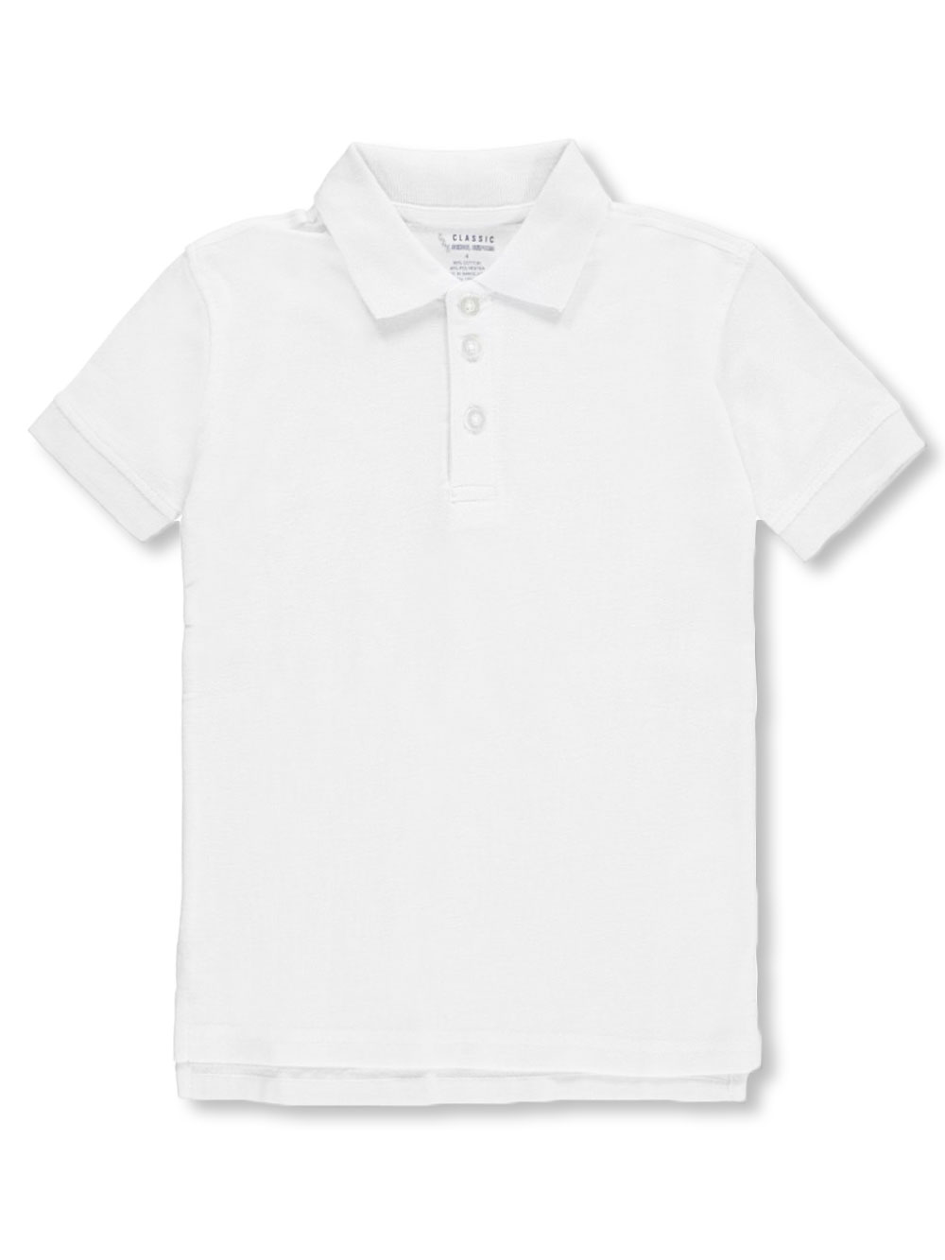
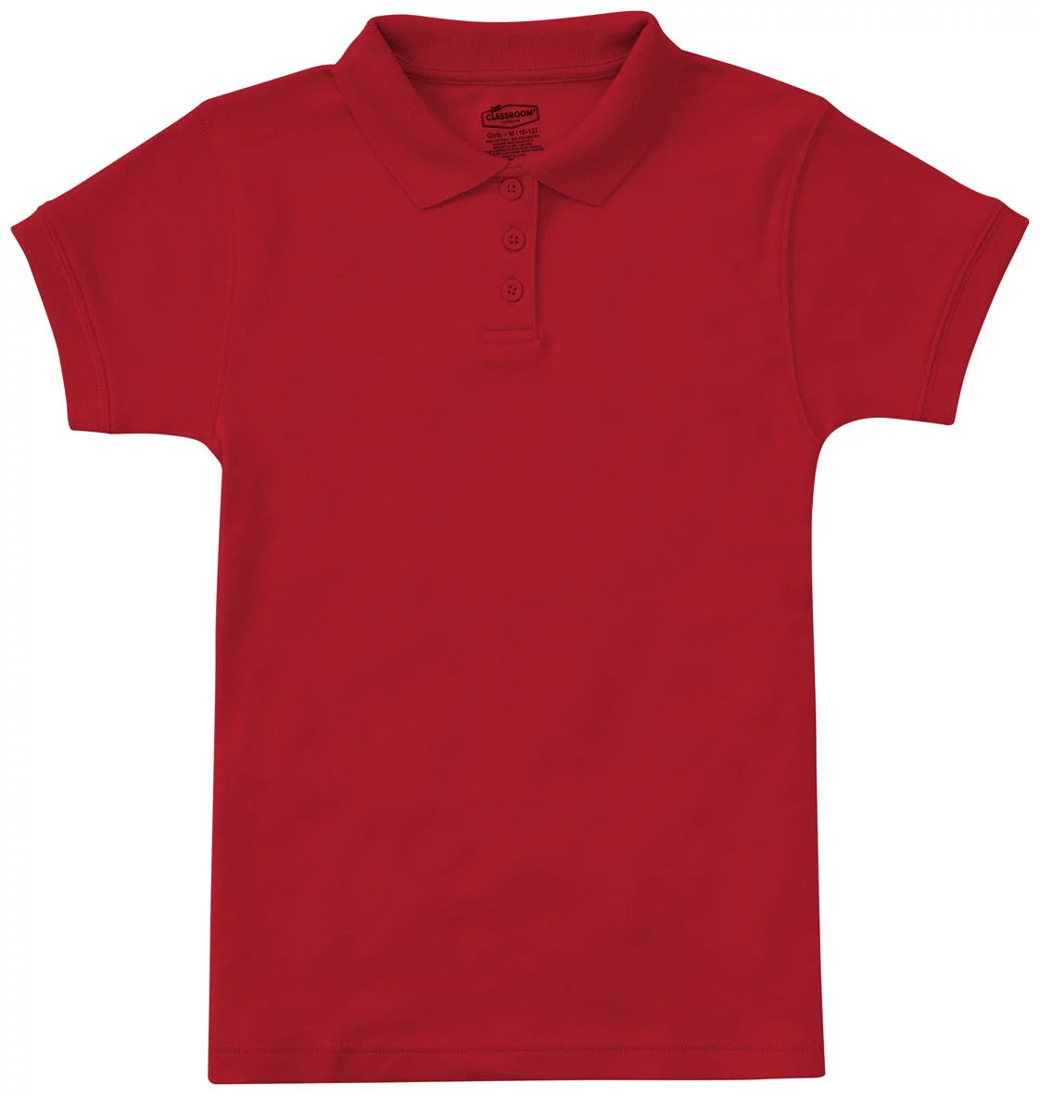
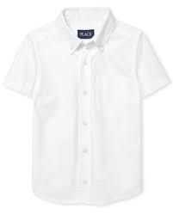
Polo Shirt
Polo Shirt
Polo Shirt
Oxford Shirt

Slide 12
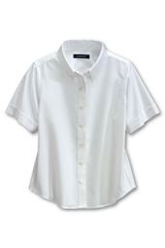
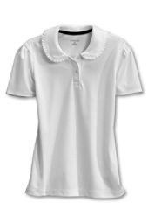
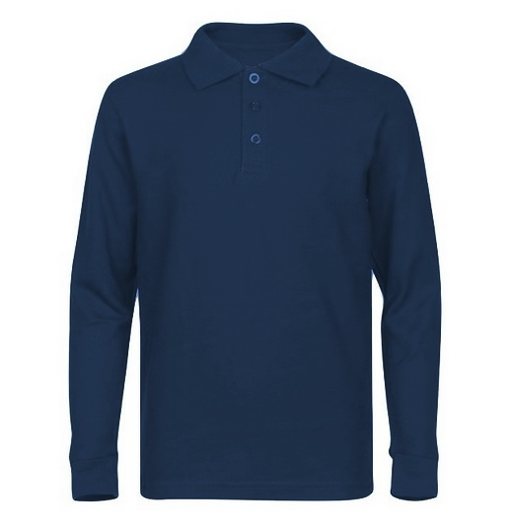
Oxford Shirt
Polo Shirt
Polo Shirt

Slide 13
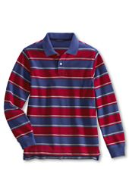
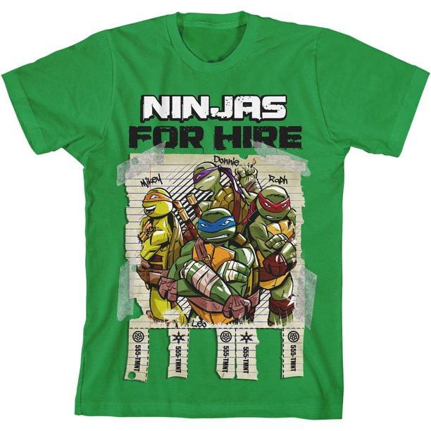

Unapproved
Stripes

Slide 14
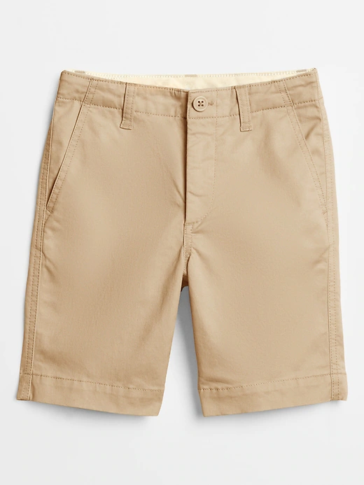
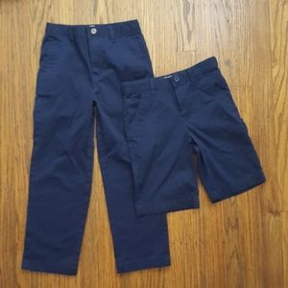
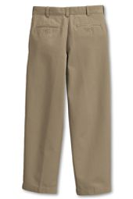
Pants/Shorts
Pants
Khaki Shorts

Slide 15
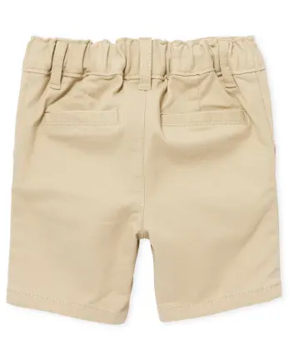
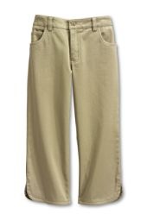
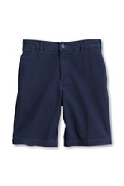
Capri Pants
Shorts
Shorts

Slide 16
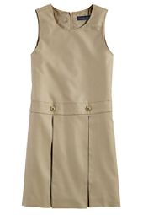
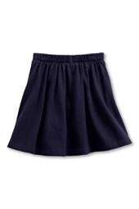
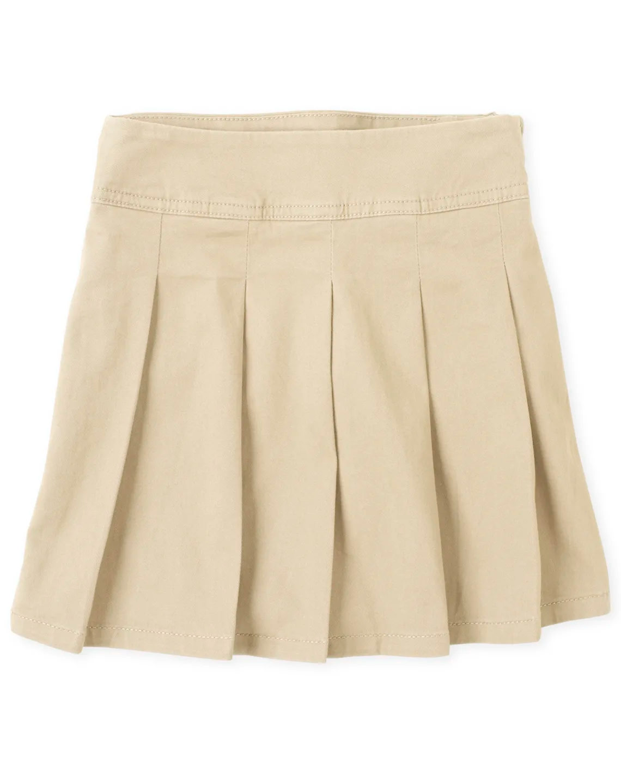

Skirts
Jumper – Collared shirt must be worn underneath.

Slide 17
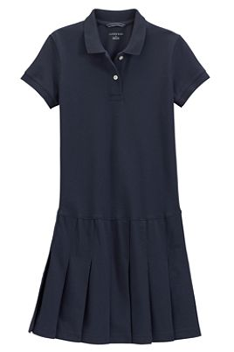
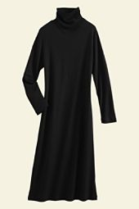
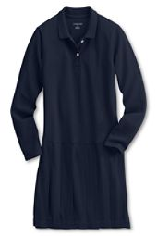
Turtleneck Dress
Polo Dress
Polo Dress

Slide 18
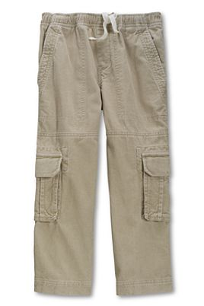
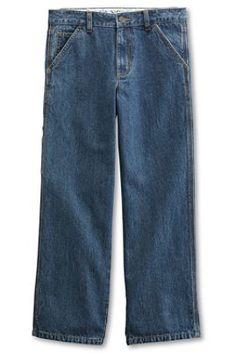
Cargo Pockets
Blue Jeans

Slide 19
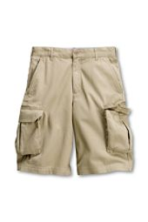
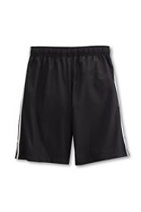
Cargo Shorts
Stripes on Shorts

Slide 20
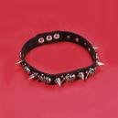
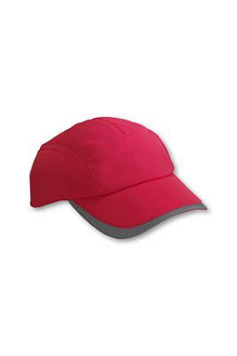
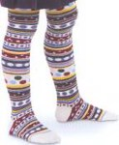
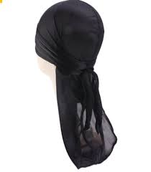
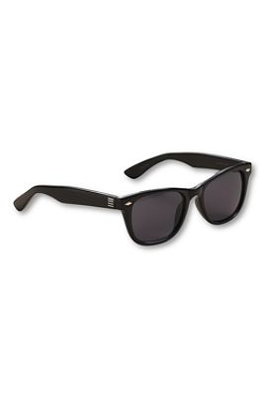
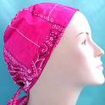
Tights
Spike Necklace
Hats
Durag
Sunglasses
Bandana

Slide 21
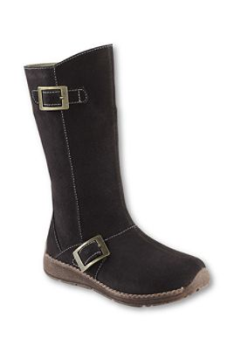
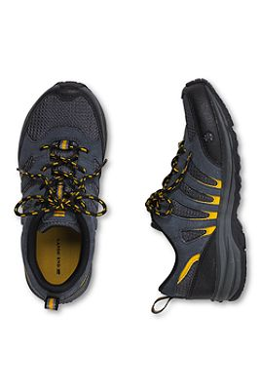
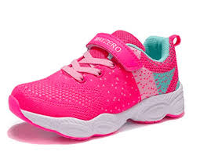
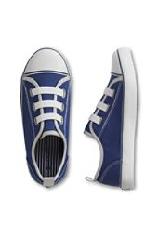

Slide 22
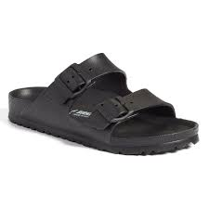
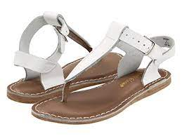
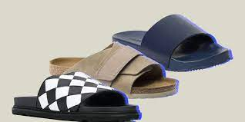
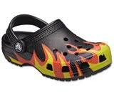
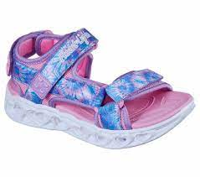
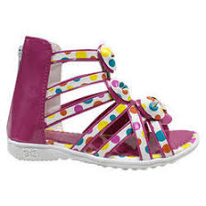



Slide 23

Questions/Concerns
School Information: Ponce de Leon Elementary School
              1301 Ponce de Leon Blvd
              Clearwater, FL 33756
              727-588-3573

